Slide 1








BUILD BACK BETTER
Team Dino
Tun Yè Minn
Aung Bo Bo
4th Year, UIT
4th Year, UIT
Business Information System (BIS)
Knowledge Engineering (KE)

Slide 2



Description of Submission
The coronavirus pandemic is causing large-scale loss of life and severe human suffering globally. It is the largest public health crisis in living memory, which has also generated a major economic crisis, with a halt in production in affected countries, a collapse in consumption and confidence, and stock exchanges responding negatively to heightened uncertainties.
The economic shock of the COVID-19 pandemic inevitably invites comparisons to the global financial crisis of 2008-09. As in 2008-09, governments have again intervened with monetary and fiscal policies to counter the downturn and provide temporary income support to businesses and households. But restrictions on movement and social distancing to slow the spread of the disease mean that labor supply ,working areas and youths (15-24) are today directly affected in ways they were not during the financial crisis. Whole sectors of national economies have been shut down, including hotels, restaurants, non-essential retail trade, tourism and SMEs.
The global economy is expected to head into recession – almost 11 years after the most recent one – as the COVID-19 pandemic continues to shutter businesses and keep people at home. While world-wide the number of COVID-19 continues to increase up to this moment and we are becoming hopeless day by day. So, this submission explores the challenges and opportunities to tackle the uncertainties brought by the crisis and a way to build back our economy prosperously and help eliminate problems in achieving decent work especially for youths during the crisis and for future by guidance of ASEAN Economic Community (AEC) 2025 Blueprint.
Notes:
Currently, coronavirus pandemic is the largest public health crisis in living memory, which has also generated a major economic crisis, with a halt in production and consumption.

Slide 3
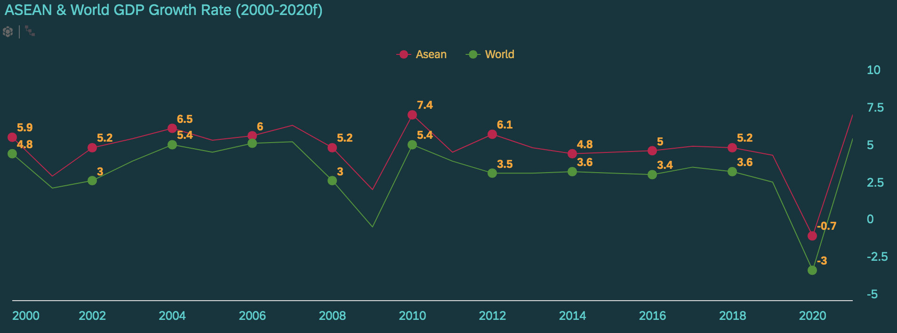
Economic Crisis through History
In 1997, the Asian Financial crisis
gripped much of East Asia & Southeast Asia and raised fears of a worldwide
economic meltdown.
In 2007 - 2009, a depreciation in the
subprime mortgage market in the
United States was followed by a global
economic downturn.
Now in 2020, the COVID-19 pandemic
has disrupted economic activities and
upended lives, tapering growth
prospects around the world.
Notes:
As we see here the global gpd is expected to have a sharp decline in 2020 up to -3% and ,for ASEAN it expected decline -0.7%.
So, our global economy is expected to head into recession – almost 11 years after the most recent one.

Slide 4
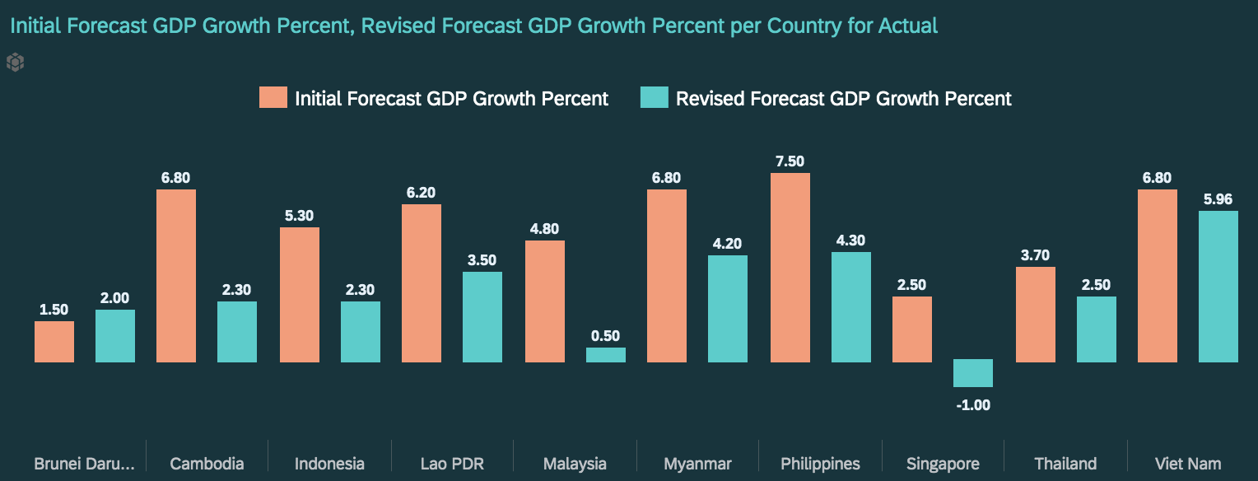
ASEAN GDP FORECAST
9 out of 10 ASEAN
countries would decrease
in GDP Growth due to
Covid-19 Pandemic.
Singapore hits the most with -1%.
Cambodia and Malaysia having almost same large gap followed by Philippines, Indonesia, Lao PDR, Myanmar, Vietnam.
The worsening of economic conditions and the crisis has lowered the forecasts of each country’s GDP growth.
We can only expect to see a sharp slowdown or recession in all of the ASEAN economies in 2020.
Notes:
Here we can see a big difference between Initial and revised forecast of GDP growth.
Due to the impact of the crisis, each country suffers differently based on its strength.
We found that 9 out of 10 ASEAN countries would decrease in GDP Growth due to Pandemic.
Singapore hits the most with -1%.
Other countries also have a large gap between these two forecasts.

Slide 5
Sectors of Economics
So, where to Focus……?
Trades in ASEAN
The importance of exports and imports that plays the major contribution in economy.
Major sectors of econmy which reflect a country’s growth rate and its GDP.
Economics
Deceleration
Small to Medium Enterprise
Major part of ASEAN’s economy and the outcomes on it because of the crisis.
World of Work
The vital role of man- power that fuel the survival of economy.
Notes:
So, where do we focus?
Our ASEAN economy is composed of various domains.
To build back our economy, we should focus on these 4 main things.
Major sectors of the economy.
Trades in ASEAN
ASEAN's SMEs and
World of Work

Slide 6
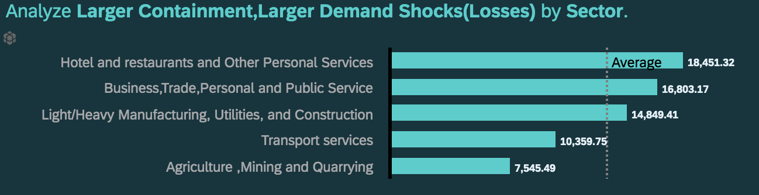
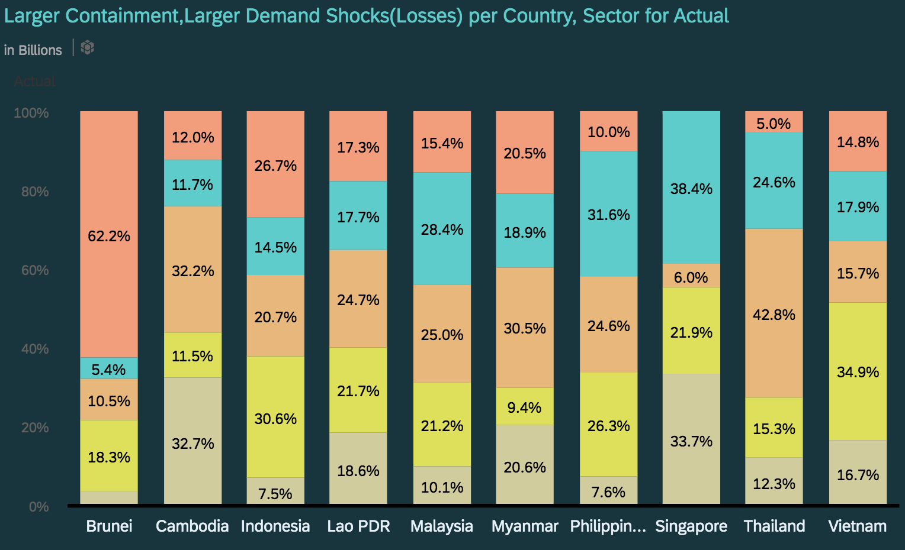
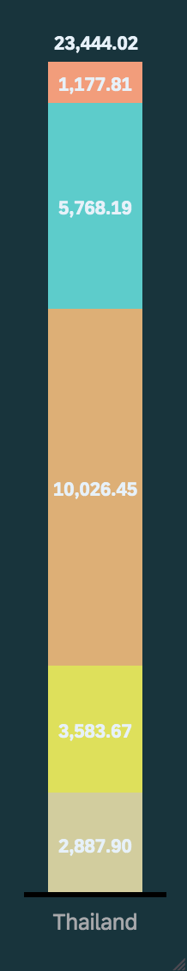
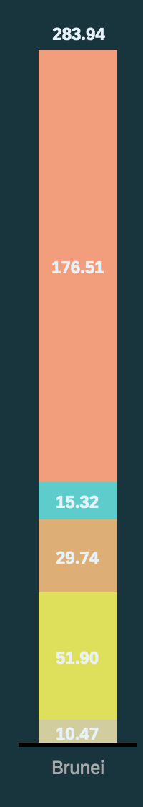
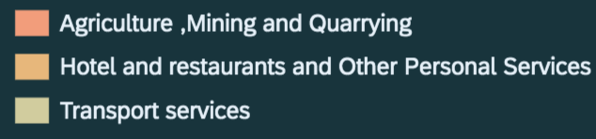

Issue 1:Expected losses in ASEAN Economy by sectors
Demand shock(losses) per Country, Sector for Actual
283.94
1821.33
9892.22
362.29
8011.02
2157.18
5357.62
9512.97
23444.02
7166.55
Sharp drop in domestic demand have large effects on these economies since
60%
of ASEAN GDP is from consumption
3.69%
with Singapore being an exception.
3.89%
Hotel and restaurants and other Personal Services has the highest demand shocks showing 36%
from average.
Thailand is expected to lose most with $23444.02M in “Demand Shock” while Brunei lose the least with $283.94M.
Notes:
Because of the current economic crisis, there has been a “great demand losses” for most of the goods.
On the left, we can see the demand shocks for the following sectors.
We found out that a sharp drop in domestic demand has large effects on these economies since 60% of ASEAN GDP is from consumption.
On the right, we can see the average of the larger demand shock by each sector.
Hotels and Services have the highest demand shocks.
We found that during this economic crisis, Thailand is expected to lose most in "Demand Shock" while Brunei loses the least.

Slide 7
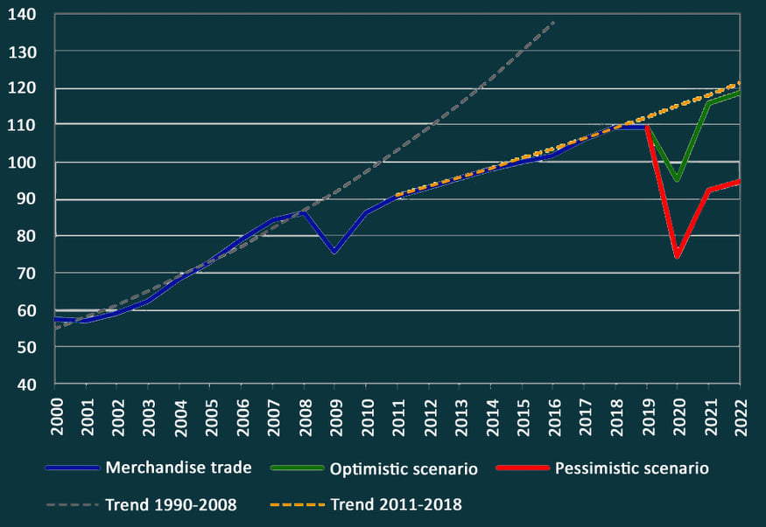
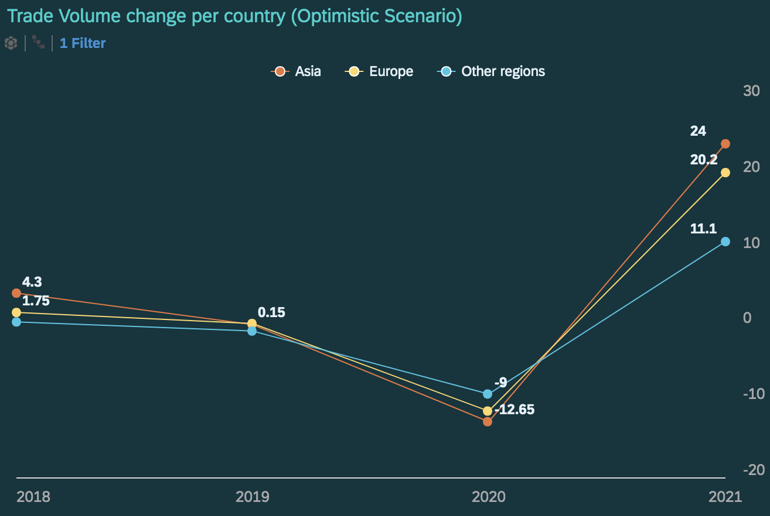
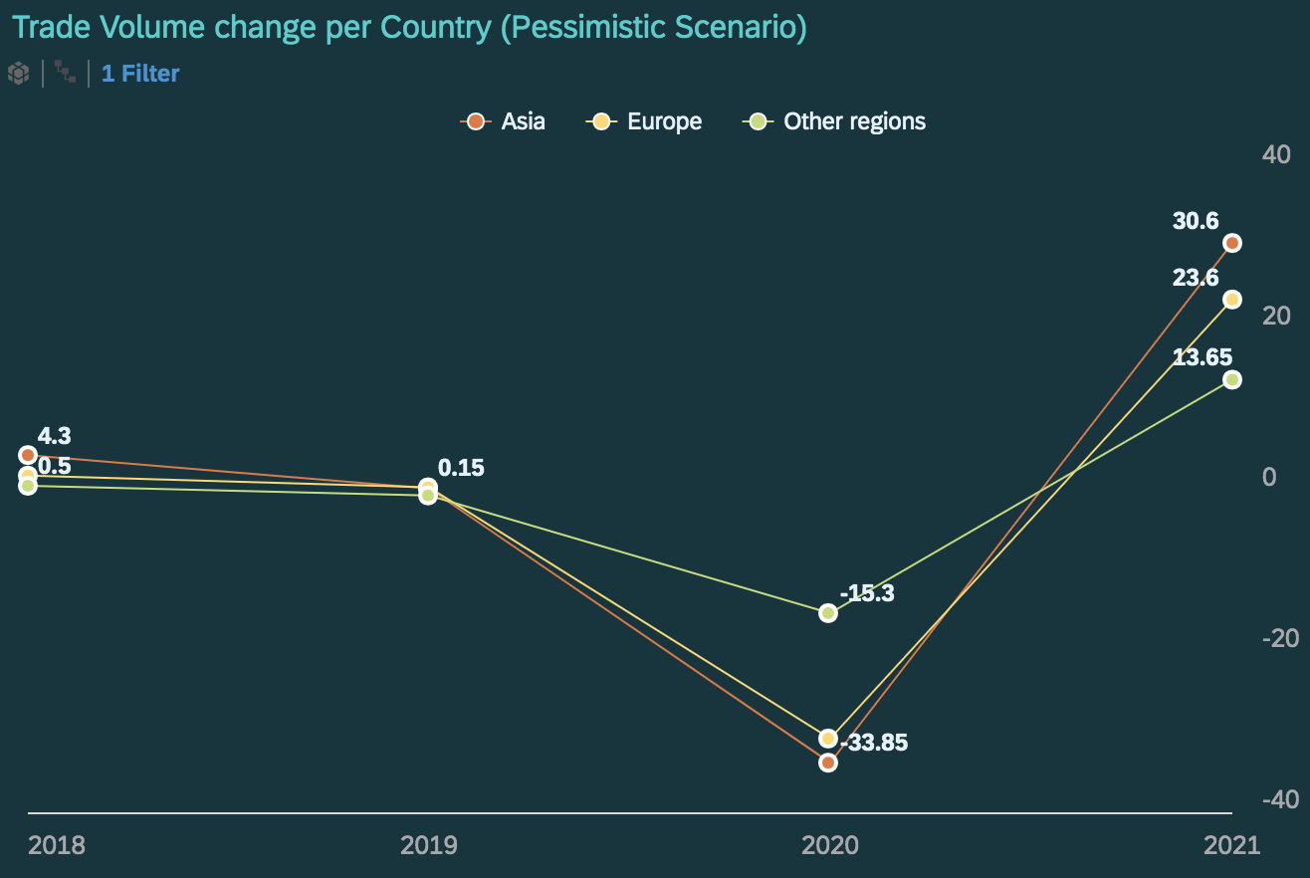
Issue 2: Impact of Trade on Economy (World & Asia)
Nearly all region will suffer
World Trade Volume
Double Digit
Index,2015=100
decline in trade Volumes
with exports from Asia hit hardest.
World Merchandise trade is set to plummet between
13% - 23%
In 2020
due to the pandemic.
Trade will likely fall steeper in sectors with complex value chains, particularly electronics and automotive products.
Source: WTO Secretariat
Services trade may be most directly affected by the pandemic through transport and travel restrictions.
1.75
0.3
0.5
0.3
-0.7
In 2020, Asia has a potential to become the lowest in Trade Volume worldwide but it is expected to overcome its Trade Volume by becoming top in 2021.
-0.7
-11.25
-30.85
Notes:
We found that after the financial crisis of 2008, the trade never returned to its previous trend.
The current economic crisis has double the previous crisis's effect.
The World Merchandise trade is set to plummet between 13% to 23% in 2020 due to the crisis.
In both optimistic and pessimistic scenarios, Asia has the potential to become the lowest in Trade Volume worldwide than Europe and other regions in 2020.
Because of the pandemic, nearly all regions will suffer Double-Digit decline in trade Volumes with exports from Asia hit hardest.

Slide 8
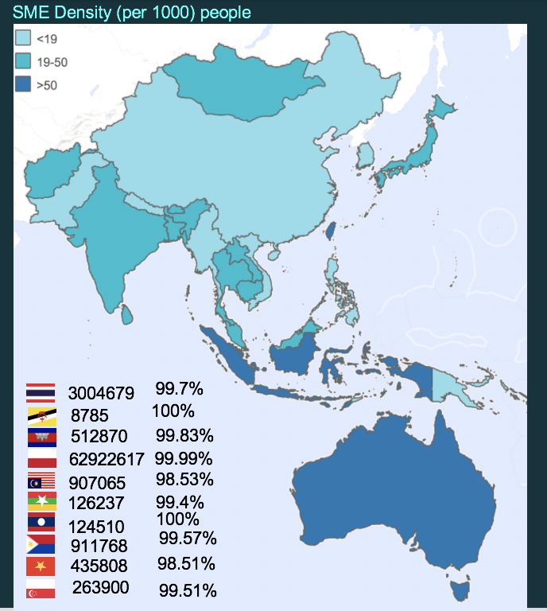

Issue 3: Impact of SMEs on Economy (World & Asia)
SMEs accounts for between
89% - 99%
&
90%
of total establishments
Europe & Central Asia
35027833 MSMEs
North America
33729168 MSMEs
MENA
10066801 MSMEs
of total employments
in the ten ASEAN Member States (AMSs).
East Asia and the Pacific
102289112 MSMEs
South Asia
75924258 MSMEs
Countries like (Laos ,Indo ,Thai) with
100%
Dependence on SMEs
= more vulnerable to the impact of crisis.
LAC
17217911 MSMEs
Sub-Saharan Africa
48185712 MSMEs
No of Enterprise
total SMEs %
ASEAN SMEs have less than
Impact of crisis may result in up to
2 Months
Cash reserve
6%
&
50%
drop of global GDP
in
April
whilst over a third
expected to lay off over
of SMEs worldwide
40%
of their staff.
are at risk for bankruptcy in the short period.
Source: SME Economic Forum
Notes:
SME are also important for local economy growth. According to the image.
We found that SMEs account for between 89% - 99% of total establishments & 90% of the total employment in ASEAN countries.
Countries like (Laos, Indo, Thai) with 100% dependence on SMEs means more vulnerable to the impact of the crisis.
Globally, crisis on SMEs may result in up to a 6% drop of global GDP.

Slide 9
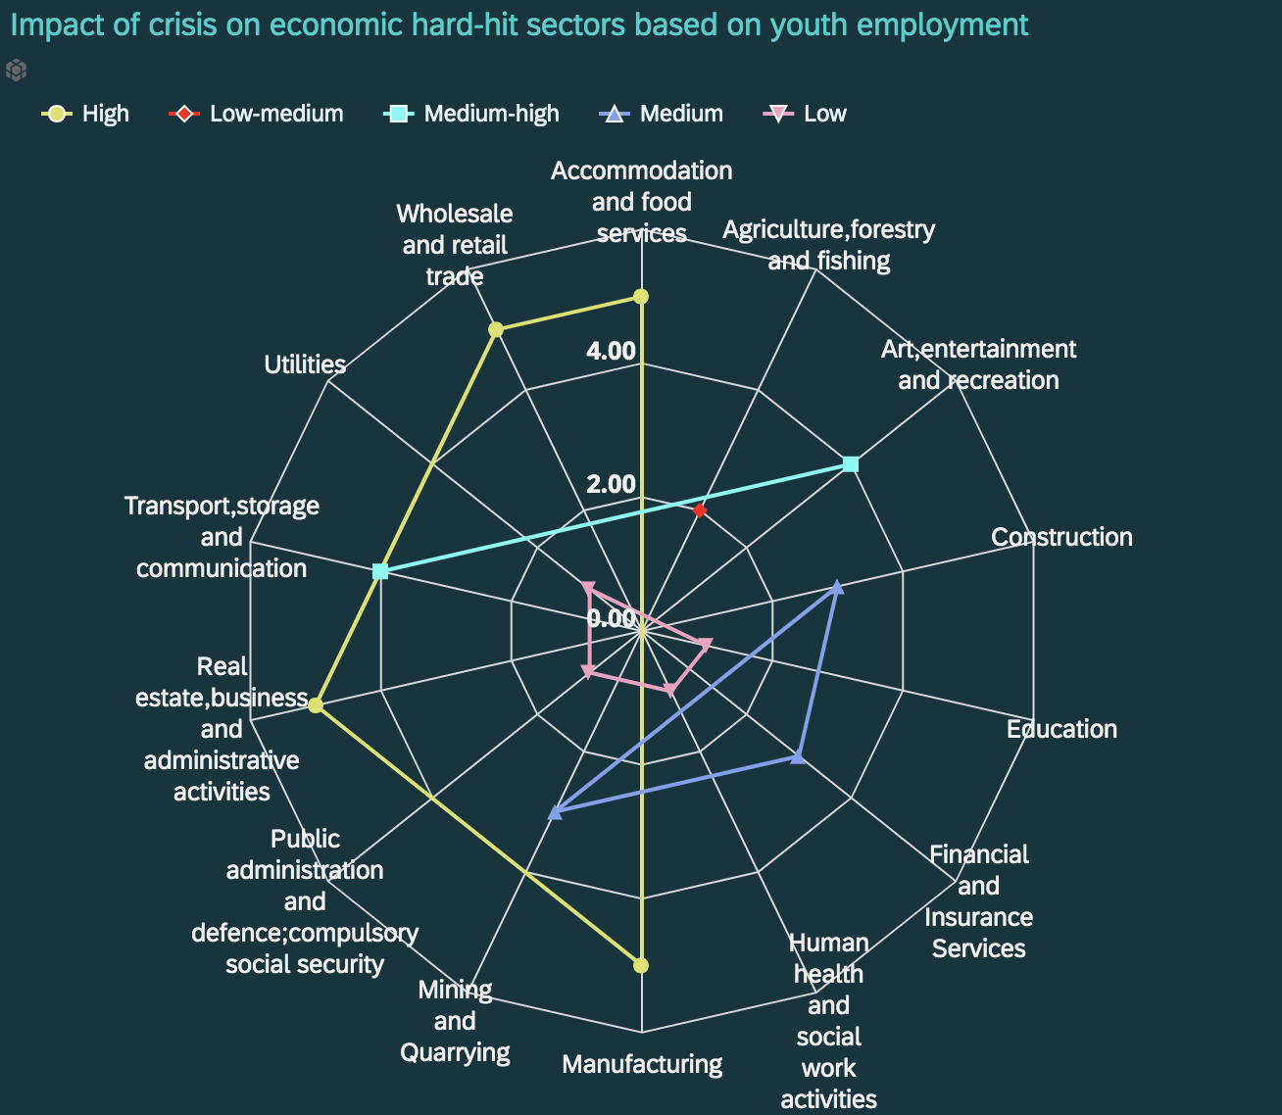
Issue 4: The Impact of crisis on “World of Work”
4 in 10 people employed globally are working in hardest-hit sectors.
Around
Before the onset of the crisis
436 M
Enterprises in hardest-hit sectors
57%
of working aged workers
with
178 M
= 3.3 B
young workers at the beginning stage of the crisis.
workers
were employed Worldwide.
Young people of about
Almost
11.8 M
working in Human
and Social work activities has
3/4
(three-quarters) of young people
working in the
hardest-hit sectors are
Informally employed.
serious risks of exposure to COVID-19 in workspace.
Notes:
In worldwide, around 436M Enterprises in hardest-hit sectors with 178M young workers at the beginning stage of the crisis.
We found out that sectors like Manufacturing, Real Estate, Wholesale & Food services are hit hardest during the economic crisis.
Young people about 11.8 M working in Human and Social work activities have serious risks of exposure to COVID-19 in the workspace.

Slide 10
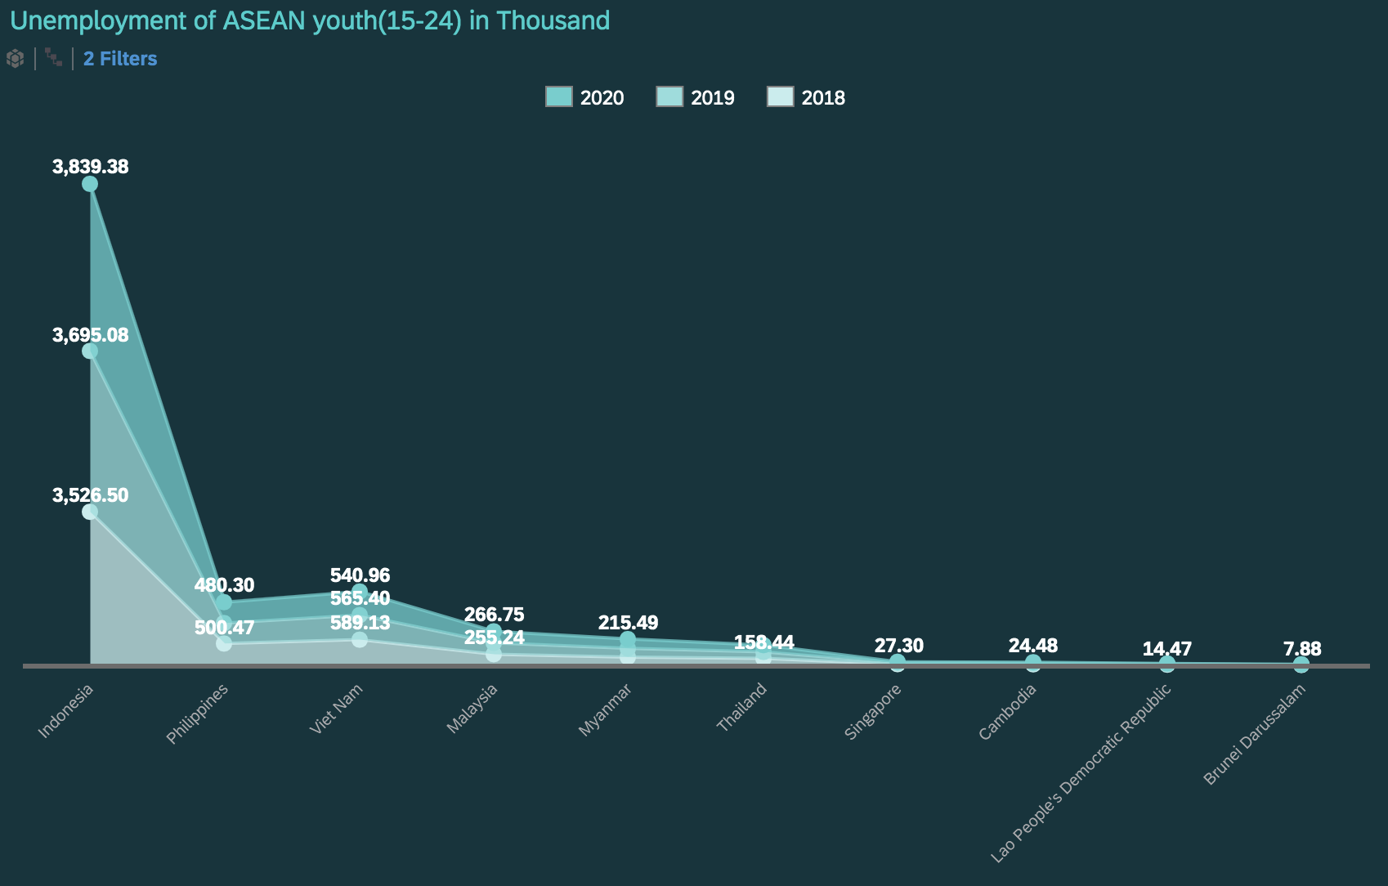
Issue 4: The Impact of crisis on “World of Work”
At global level young people aged
15-24 are around
3x
more likely to be unemployed
compared with adult aged 25 and above.
Youth unemployment rate in Asia and The Pacific region has risen
14.1%
in 2020 compared to
13.7%
in 2012 globally.
On the onset of the crisis, unemployment
470.82
266.75
155.31
13.86
affected 67.6M Young women & men
258.93
149.14
14.27
7.79
198.71
189.32
27.19
23.81
7.72
= 13.6%
27.24
22.93
of youth labor force.
NEET rate in Asia is
24.4%
in 2020 compared to
global rate of
22.3%.
1 in 6 young people lost job because of the crisis.
Even prior to the pandemic
267 M
young women & men were NEET.
Notes:
We found out that Indonesia has the highest rate of unemployment and Brunei with the lowest in 10 ASEAN countries throughout 3 years.
At the global level young people aged 15-24 are around 3x more likely to be unemployed compared with adults aged 25 and above.
The Youth unemployment rate in Asia and The Pacific region has risen 14% in 2020.
NEET rate in Asia is 24% compared to the global rate of 22%.

Slide 11
The Impact of crisis on “Working Hours”
2020Q1 : 3%
2020Q2 : 12.9%
Americas
Europe and Central Asia
2020Q1 : 1.7%
2020Q2 : 13.1%
2020Q1 : 6.5%
2020Q2 : 10%
Working Hours have been cut by
since the onset of the pandemic.
23%
Asia and the Pacific
4.8%
of working hours were lost in Q1
which effected on
125 M
&
305 M
full-time jobs in Q1
Africa
full-time jobs continued in Q2
2020Q1 : 1.7%
2020Q2 : 9.5%
2020Q1 : 2.1%
2020Q2 : 10.3%
Arab States
Notes:
This is the impact of the crisis on “Working Hours”.
Working Hours have been cut by 23%, since the onset of the pandemic.
Globally, 4.8% of working hours were lost in Q1 which effected 125M full-time jobs and 305M full-time jobs continued in Q2.
We found that working hours lose in Asia and the Pacific regions’s is 6.5% in Q1 and 10% in Q2.

Slide 12
The hard-hit Sector ‘Travel & Tourism’
Travel & Tourism
Global economic
impact of COIVD-19
Travel & Tourism jobs 2019
UNPRECEDENTED PROJECTED JOB LOSSESS FOR 2020
330
Million
Travel & Tourism jobs
5x
100.8
= 1 in 10 jobs
Million
the impact of the
1 in 4 of all net new jobs were created by Travel & Tourism
over the last five years
2008 Global
Financial Crisis
Job losses
31%
Travel & Tourism GDP 2019
Travel & Tourism GDP
Global unemployment rate
2.7
10.3%
of global
economy
2.9
percentage
point
Trillion
= $8.9 trillion
USD
30%
3.5% Travel & Tourism GDP growth vs 2.5% real economy
GDP growth
Directly from travel & tourism
job losses
Notes:
In 2019, TT created 330M jobs which is 1 in 10 Jobs and 10% of Global economy.
In 2020, because of the pandemic, 100M of TT jobs and 30% of Global GDP were lost worldwide.
Economic impact on TT is 5x bigger than the 2008 crisis and global unemployment rose 2.9%.

Slide 13
Recommendations for recovering demand shocks
Aggregate demand reflect the way of increase and decrease in GDP.
To ensure the essential needs for survival, agriculture and medical sectors must not be restricted.
Solutions to Increase demand
Investment
Consumption
Rise in expected rate of return, drop in interest rates, rise in business confidence
Decrease in taxes, increase in income, fall in interest rates, desire to save less
Net exports
Government
Increase in foreign
demand, relative price
drop of goods
Increase in
government spending, decrease in taxes
Our aim is to create a more dynamic and resilient foundation for economic sectors which will be capable of responding and adjusting to emerging challenges throughout current and upcoming pandemics.
Notes:
These are the recommendations for the following issues.
For demand shocks, we can focus on these 4 main things.
In INVESTMENT
-Governments and investors should invest in these sectors to increase the expected rate of return and drop in interest rates.
In NET EXPORT
We should increase in foreign demand with export and drop the price of relative goods.
In Consumption
Each country should decrease its taxes and in interest rate so that some sectors can maintain their works and
People should desire to save less to have enough goods and demands.
For GOVERNMENT
Each respective country should increase Government spending and reduce taxes.

Slide 14
DO and DON’T TRADE POLICY RESPONSES
Do facilitate access to essential goods and supplies.
SDG Goal 8 : Target 8.A
Do support consumption of essential items and limit negative impacts on the poorest.
Do not constrain investment & access to essential goods and supplies by imposing export taxes or bans on COVID-19 related medical goods, the materials.
DO
Do support exporters to maintain jobs and foreign exchange earnings.
Do contribute to macroeconomic policy efforts to shield economy from COVID related downturn.
Do not undermine consumption of essential good or constrain job maintaining exports by arbitrarily closing borders to commerce.
DON’T
Do streamline regulatory and border procedures to facilitate access to COVID-19 related medical goods and essential food products.
Do not impose additional trade restrictions to protect domestic industries that may be adversely affected by falling demand.
Our aim is to reduce or eliminate regulatory barriers brought by the pandemic which impede economy’s trade freedom by disturbing competitive, efficient and seamless movement of goods within and outside the regions.
Notes:
For the trading sector here is recommended do and don’t policies
During this situation it should facilitate to access essential goods and supplies and need to limit negative impacts on the poorest.
We need to support exporters to maintain jobs
We should contribute to macroecomic policy and
Also need to support streamline and regulataory border procedures
Some don’t policies are
- don’t constrain investment & access to essential goods and supplies
- Don’t undermine consumption of essential good or constrain job maintaining exports
- Don’t impose additional trade restriction to protect domestic industries

Slide 15
Recommendations for SME
SDG Goal 8 : Target 8.3
1
3
5
Ease liquidity constraints towards the deferral of tax, social security payments, debt payments and rent and utility payments
Introduce targeted working time shortening,
temporary lay-off and sick leave for workers
Enhance the governance of SME related policy responses by monitoring the crisis
Place structural policies to help SMEs adopt new working Methods and (digital) technologies to continue operations
Provide loan guarantees through public institutions to SMEs
2
4
Our aim is to have more structured and targeted SME programs which enhance their resilience and to provide technical and financial assistance from governments throughout the pandemic to maintain the GDP growth.
Notes:
For SMEs
Ease liquidity constraints towards taxes and payments.
Provide loan guarantees to SME
Introduce targeted working time and sick leave for workers
Place structural policies to help SMEs adopt new working Methods and technologies
Enhance SME related policy responses by monitoring the crisis.

Slide 16
4 Pillars Framework for World of work
Stimulating
the economy and employment
Supporting enterprises, jobs and incomes
Protecting workers in the workplace
Relying on social dialogue for solutions
Notes:
.For World of Work
This is the 4 Pillars framework proposed by ILO.
That includes Simulating economy, Protecting workers, Supporting Enterprises and Relying on social dialogue for solution.

Slide 17
Recommendations for Youth Unemployment & Job losses
Step 1
Step 4
Countercyclical fiscal policy to ameliorate youth unemployment
Macroeconomic policies to stimulate economy and create jobs quickly.
Step 2
Step 5
SDG Goal 8 : Target 8.6,8.8,8.B
Enhance youth skills , productivity & reduced labor demand
Wage subsidy programs and work sharing arrangements for youth.
Step 3
Step 6
Use economic and employment policies by respective governments.
Social protection and
health insurance to
prevent job losses
Step 7
Ensure government policies do not exclude or marginalize those working in “gig economy” in order to keep the jobs.
Our aim is to eliminate the existing barriers along with the new ones brought by the pandemic for obtaining decent jobs and safe work environments for youths (15 - 24). We believe that youths are the future of our economy as they play the vital role in all aspects.
Notes:
.For Job Loss and unemployment for youth
1.Use countercyclical fiscal policy for youth unemployment.
2.Enhance youth skills through programs
3.Use economic and employment policies by respective governments.
4.Use macroeconomic policies to stimulate economy and create jobs
5.Promote wage subsidy programs and work sharing arrangements for youth.
6.Provide social protection and health insurance and
7.Ensure government policies do not marginalize those working in “gig economy”.

Slide 18
Hotel and Tourism Sector Recommendation
SDG Goal 8 : Target 8.9
Promote safe destination programs
Draws up continuity plan for ministry
2nd
4th
1st
3rd
5th
Provides
up to date information
Elaborates short run and long run package
Develop plans
to recover the international market
Our aim is to provide up to date info about safety & security for tourists and to help people working in those communities which are mainly depended on tourisms with finance and special programs from respective governments.
Notes:
For Tourism
Provides up to date information
Promote safe destination programs
Elaborates short run and long run packages for workers and jobs.
Draws up continuity plan for ministry and
Develop plans to recover the international market

Slide 19
ASEAN’s Future economy
Is the Future to be Feared?
Three layers of digital economy
Foundation digital services (biometric,digital-ID,digital records)
Creative Content Industry
Digital payment
Digital start-ups
The Global Economy is entering
the Fourth Industrial Revolution (4IR)
Digital services
Build ASEAN Economy better with 4IR through Digital Economy
Cross-border data flows
Cybersecurity
Data-privacy
Data
Incremental benefit to
ASEAN GDP to 2030
~USD165bn
Connectivity
Digital Education
Business digitalisation
Estimated growth in ASEAN
employment in 2030
2 – 4 %
Infrastructure
The vision for ASEAN economy in 2025 is for an economically-integrated, business-friendly, trade facilitative economic region, which encourages innovation.
Notes:
For the future we should mainly focus on the 4IR through digital economy.
For Digital Economy, we can build with these 3 layers.
1.The foundation one is infrastructure layer, we can provide Connectivity, Digital Education and Business digitalization.
2.The next one is Data layer which provide Data flow, cybersecurity and Data-privacy.
3.The top one is Digital Service layer which will enhance digital services, payment and star-up.
If we could built these layers strongly, it can benefit ASEAN GDP by 165B$ and employment rate will rise up to 2 to 4% in 2030.

Slide 20
REFRENCES
https://www.ilo.org/global/topics/coronavirus/impacts-and-responses/lang--en/index.htm
https://ourworldindata.org/economic-growth
https://data.adb.org/dataset/covid-19-economic-impact-assessment-template
https://www.csis.org/analysis/economic-toll-covid-19-southeast-asia-recession-looms-growth-prospects-dim
https://www.wto.org/english/news_e/pres20_e/pr855_e.htm
https://www.statista.com/statistics/796245/gdp-of-the-asean-countries/
https://voxeu.org/article/trade-and-covid-19-wto-s-2020-and-2021-trade-forecast
https://asean.org/storage/2020/04/ASEAN-Policy-Brief-April-2020_FINAL.pdf
https://www.oecd.org/coronavirus/policy-responses/tourism-policy-responses-to-the-coronavirus-covid-19-6466aa20/#tablegrp-d1e645
https://www.ilo.org/wcmsp5/groups/public/@dgreports/@dcomm/documents/briefingnote/wcms_745963.pdf
http://www.oecd.org/southeast-asia/data/sme.htm
https://www.smefinanceforum.org/data-sites/msme-country-indicators
https://ourworldindata.org/update-sdg-tracker-2019
https://sdg-tracker.org

Slide 21
Thank You

